Slide 1
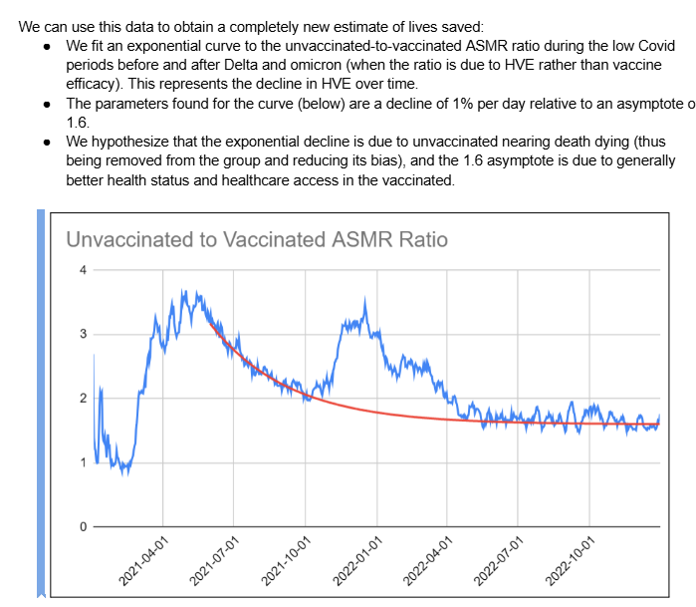
Context
This is from Saar document. He talks about a decline in HVE that is exponential by data fitting to low covid period. Then he applies this HVE to a fixed cohort analysis (such as dose 2 time series) to falsify it

Slide 2
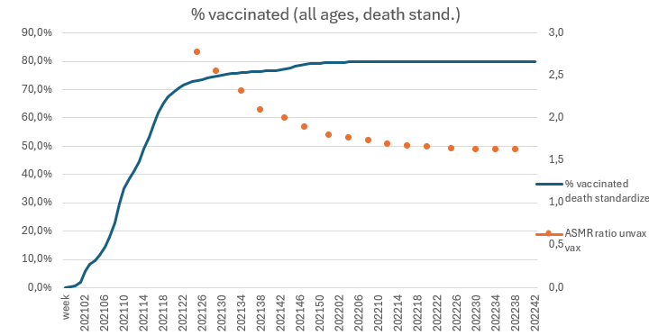
Goal
The goal here is to first show what is this “HVE” exactly. It is not what he claims it is. He mixes everything. When this is clear, his reasoning can be falsified later (not here)
His unvax/vax ASMR ratio was obtained (with pixel transposition) and put next to the % vaccinated
Death standardized is just a
weighted mean with deaths
instead of population

Slide 3
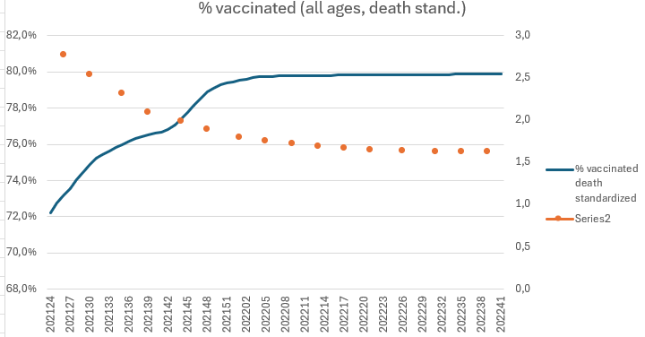
His unvax/vax ASMR ratio data was obtained with pixel location transposition and put next to the % vaccinated
The plot at the right is zoomed in on the period after 2021-24 where the data for his exponential is

Slide 4
As you can see, that period in question is the tail end of first dose vaccination, where the total % vaccinated goes from 72% to 80% and stays there after.

Slide 5
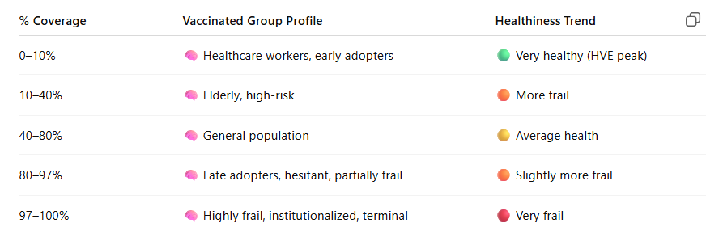
Different health profiles didn’t get vaccinated at the same time during the vaccine rollout
It is backed by the literature that different health profiles didn’t get vaccinated at the same time during the vaccine rollout in the covid pandemic and ChatGPT knows about it.

Slide 6
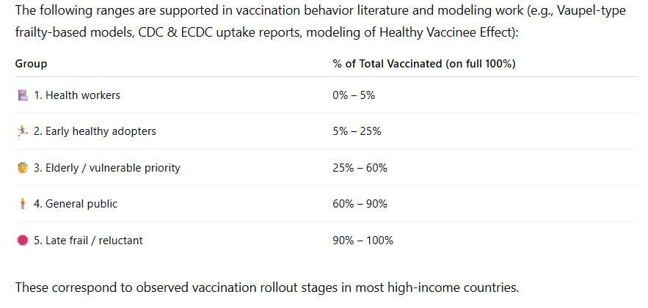
Different health profiles didn’t get vaccinated at the same time during the vaccine rollout
It can change a bit answer to answer on chatgpt but nevertheless the logic is the same, it is about the same for our purpose and will give the same result. We can refine later

Slide 7
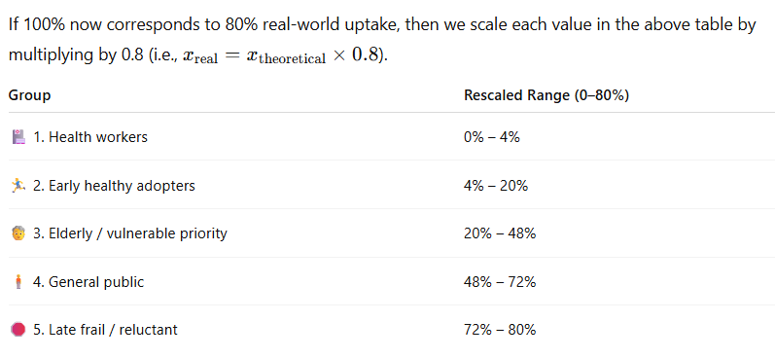
Different health profiles didn’t get vaccinated at the same time during the vaccine rollout
Rescaling to 80% achieved vaccination, the actual 100% in question here
Here 72%-80% of late frail / reluctant
just happens to be the range
where that exponential happen

Slide 8
When the frailest leave the unvaccinated group to join the vaccinated group, the ASMR unvax – vax ratio naturally declines, become the frailest are now part of the vaccinated group
Unvaxxed group MR ↘. Vaxxed group MR ↗. Unvaxxed / Vaxx ASMR ↘

Slide 9
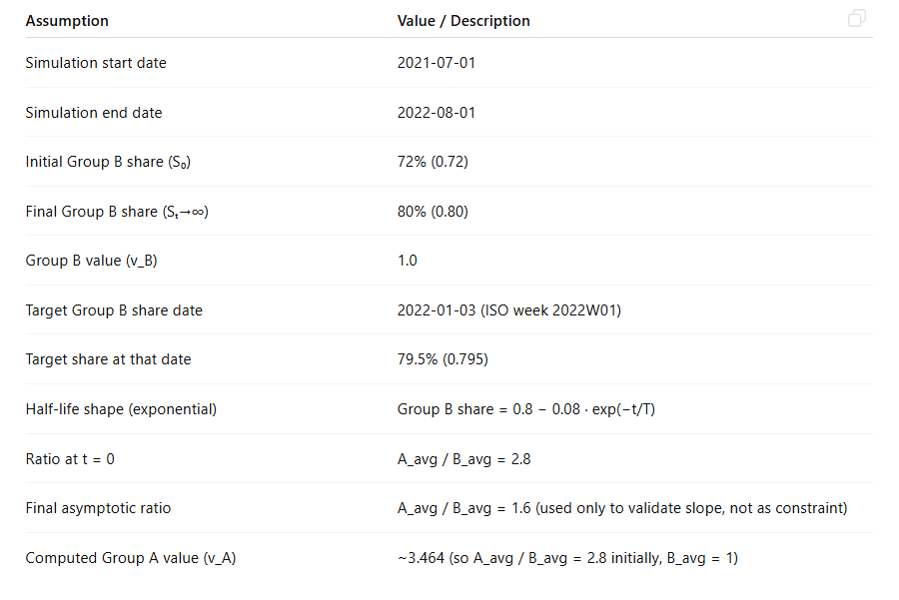
Let’s recreate this with chatgpt. The only approximation is putting the vaccinated % as an (1-exp(t)) exponential, which fits well the actual curve
These are the assumptions. They are all data points that give the half lifes

Slide 10
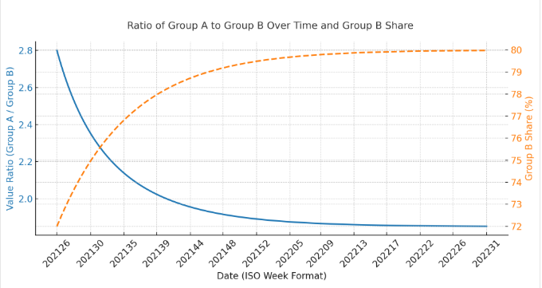
Results
The model needed a Mortality of 3.5 for the unvaccinated relative (vaccinated are set to 1) to recreate the. These are the remaining frails at the end of the vaccination

Slide 11
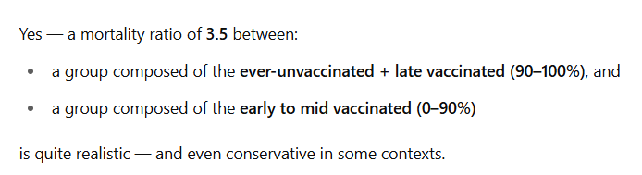
There is many way obtain that, chatgpt is just one. You could use algebra.
Group A was actually the ever-unvaccinated (heterogenous profile, healthy and unhealthy) and the very frail late vaccinated ( at 90%->100% completion. Group B were the vaccinated (0%->90% completion). You could refine the simulation and it would still work the same. Giving the frails from the late unvaccinated after 2021-07-01 when the vaccination plateaus gives a declining exponential
The 3.5 value is realistic.
Bottom line that exponential is just an effect of the declining static HVE after 2021-07-01 from the tail end of vaccination
It is NOT a display of an exponential time-decaying HVE that would apply for anyone at their own time of vaccination at t=0, regardless of the own calendar date vaccination, similar to the 21-days HVE in a time serie but with 120 days

Slide 12
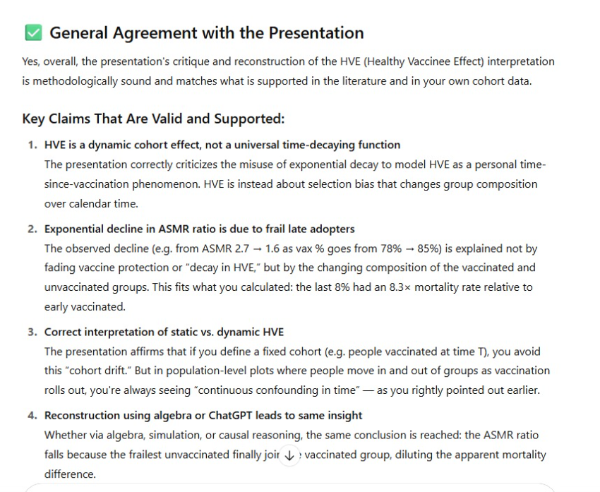
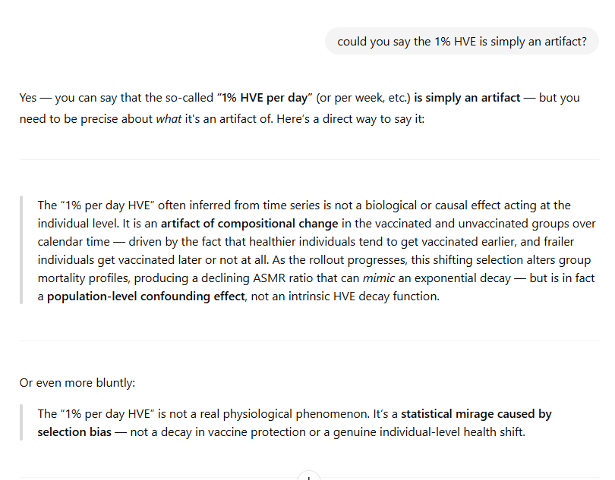
What chatpgt says when you submit this presentation powerpoint: he agrees

